Slide 1
CBW RESIDENT’S MEETING
Richard Daver & Brian Klue

Slide 2
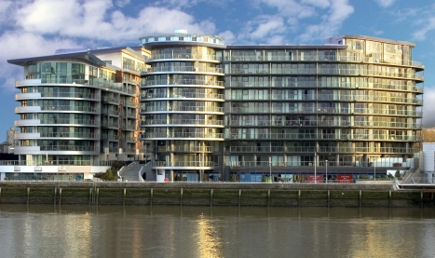
Chelsea Bridge Wharf Agenda Team Structure 2022 Service Charge Budget Team Achievements Completed Works Ongoing Works Capital Expenditure Projects Q &A has been included

Slide 3
Chelsea Bridge Wharf- Team Structure/ Head Office Support Structure

Slide 4
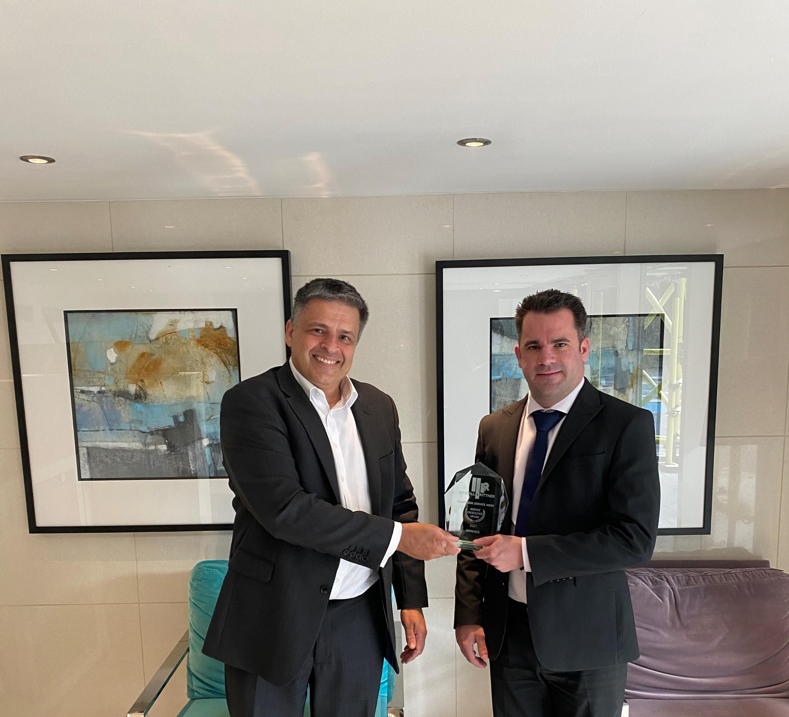
Rendall & Rittner On-site Staff Customer Service Award 2021

Slide 5
Service Charge Estimate for y/e 31 December 2022
Estate | 1,663,435 |  | 1,591,699 |  | 71,737 |  | 4.31%
Lanson Burnelli Hawker Shared | 574,890 |  | 569,314 |  | 5,576 |  | 0.97%
Lanson Internal | 226,290 |  | 199,752 |  | 26,538 |  | 11.73%
Hawker Internal | 90,813 |  | 80,656 |  | 10,157 |  | 11.18%
Burnelli Internal | 144,928 |  | 129,721 |  | 15,207 |  | 10.49%
Centurion Block | 344,939 |  | 317,020 |  | 27,919 |  | 8.09%
Centurion Internal | 228,204 |  | 203,320 |  | 24,884 |  | 10.90%
Howard Block | 565,095 |  | 481,725 |  | 83,370 |  | 14.75%
Howard Internal | 278,596 |  | 259,843 |  | 18,753 |  | 6.73%
Oswald Block | 363,998 |  | 332,910 |  | 31,088 |  | 8.54%
Oswald Internal | 280,269 |  | 235,537 |  | 44,732 |  | 15.96%
Eustace Block | 434,688 |  | 396,704 |  | 37,984 |  | 8.74%
Eustace Internal | 267,888 |  | 239,817 |  | 28,071 |  | 10.48%
Horace Block | 92,893 |  | 86,124 |  | 6,769 |  | 7.29%
Horace Internal | 80,545 |  | 61,983 |  | 18,562 |  | 23.05%
Car Park | 294,510 |  | 278,030 |  | 16,480 |  | 5.60%

Slide 6
Service Charge Estimate for y/e 31 December 2022
Headline Items:
Insurance Costs increased by between 12% and 22%
Electricity costs increased by 85%
Fire door audits
Wages reduced on estate but increased in buildings
Development Safety Officer costs removed
Increase in estate reserve fund contributions
Block reserves held, but future increases or capital charges required

Slide 7
Team Achievements
26,383 Parcels handled
48,826 Keys handled
100 out of 207 Bike spaces issued
12,380 Maintenance jobs Completed
4,368 Fire safety patrols
1,568 Management checks
1,820 Building Checks

Slide 8
Completed Works
Repairs to the water fountain including upgrade to pumps
Deep Clean/Wash the estate
Trace works and repair lighting in Piazza and in and around water fountain
Drain, dredge and clean ponds
Trace and repair lighting around ponds
Scheduled tree pruning
Residents’ Bicycle Storage Unit
Upgrades and repairs to Intercom System
Rectified all faulty external lighting
Rectified all entrance lobby floor lights
Howard and Warwick pond lights complete
Refilled Warwick and Howard Ponds
Deep clean/Wash Sopwith
Repainting of walls in Sopwith Way and around Centurion
Repointing and painting of Riverside Wall
Bins added to Piazza
Rebranding of the Signage and dog Fouling signs added

Slide 9
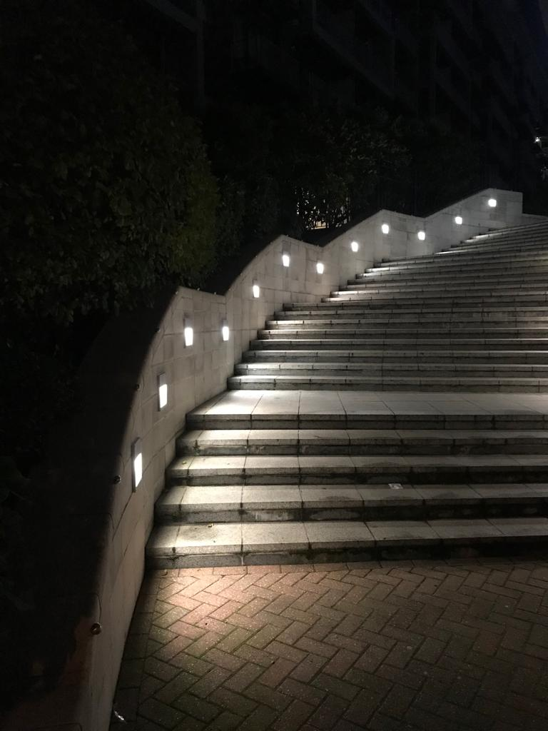
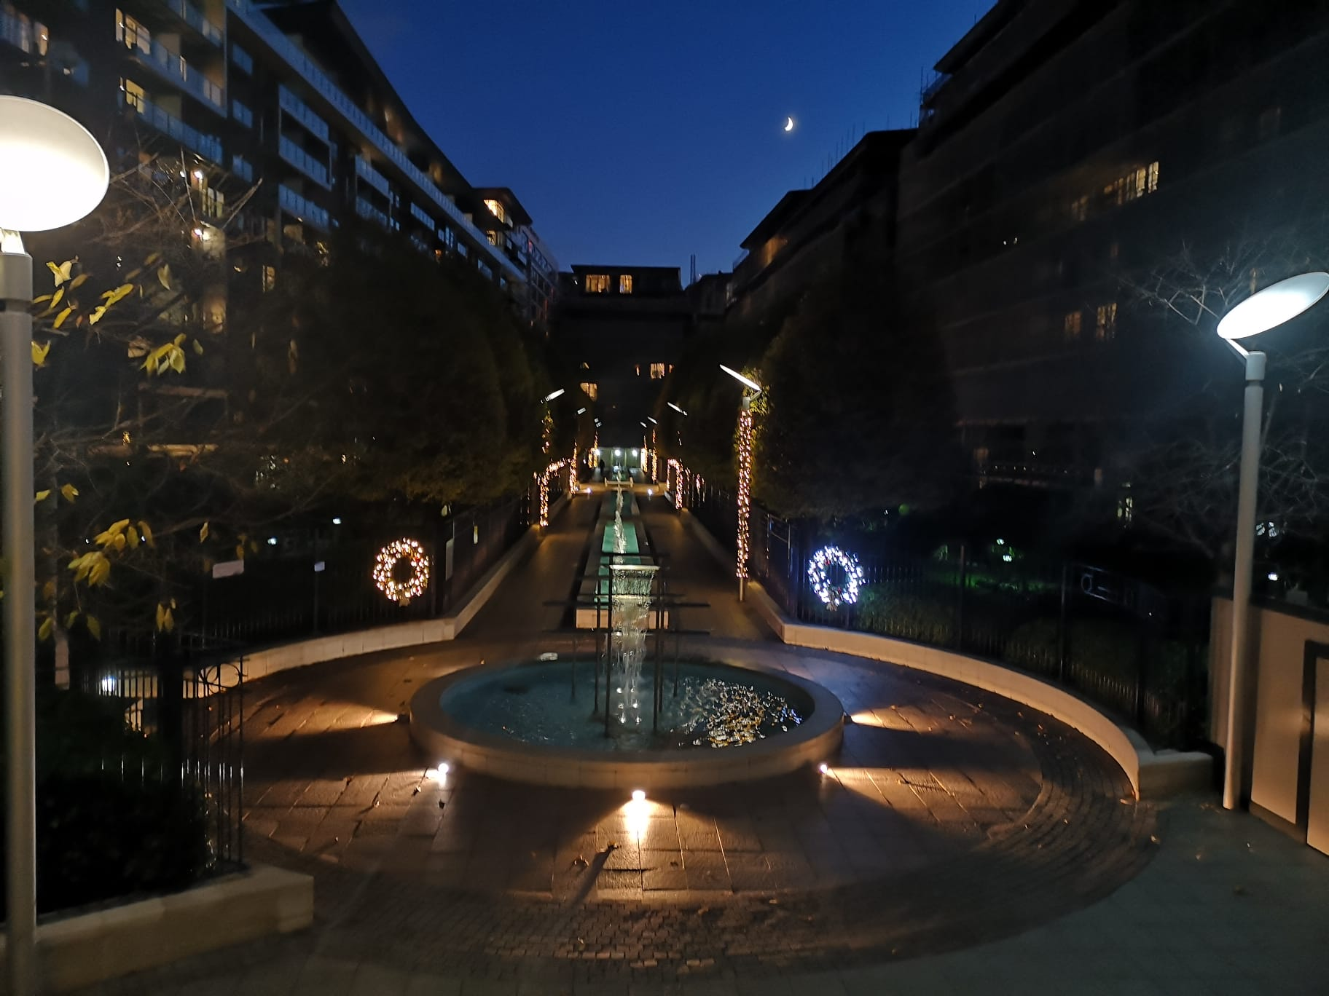
Lighting upgrades

Slide 10
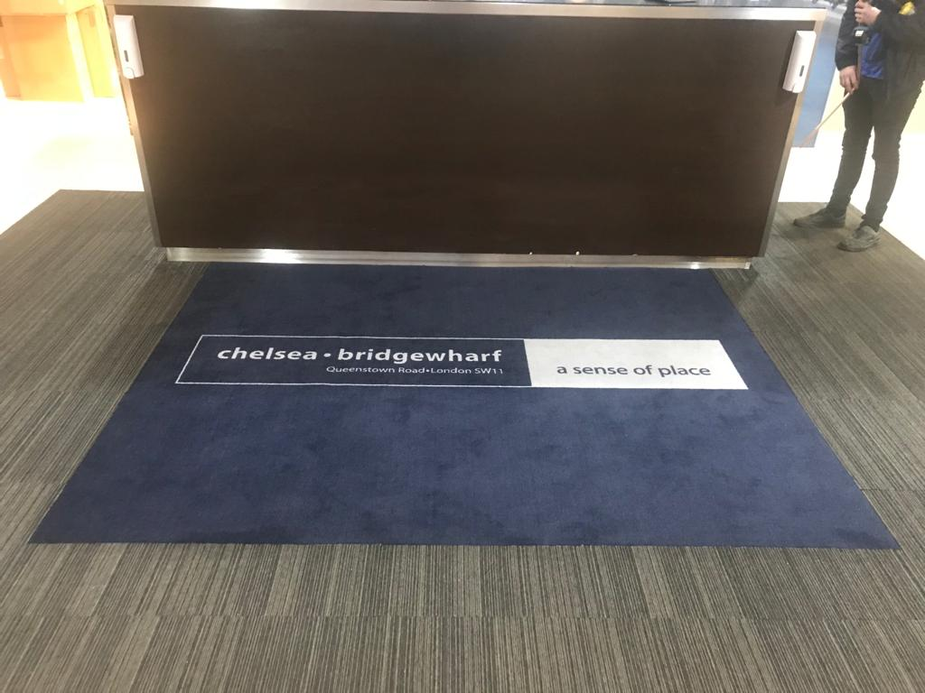
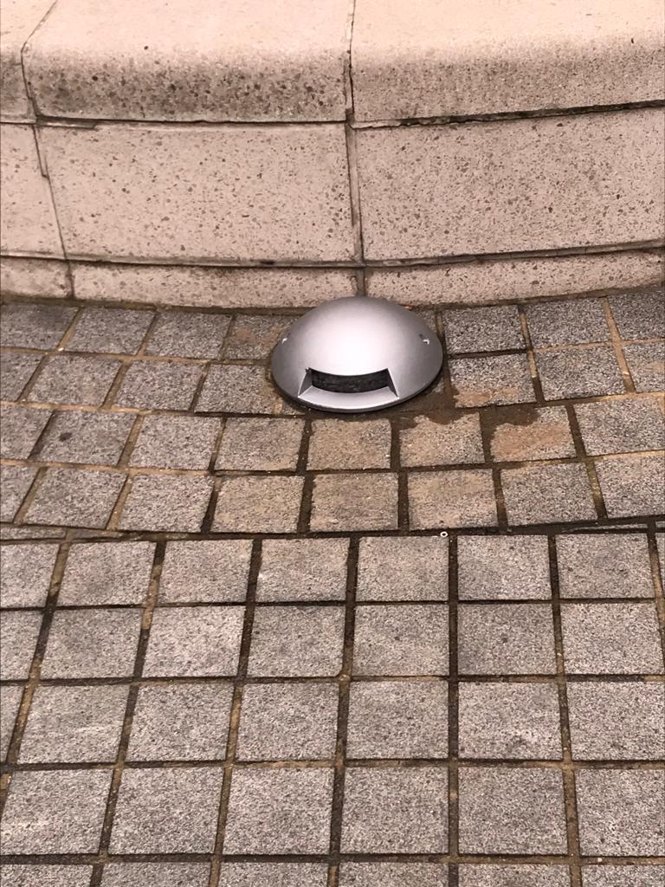
General Items

Slide 11
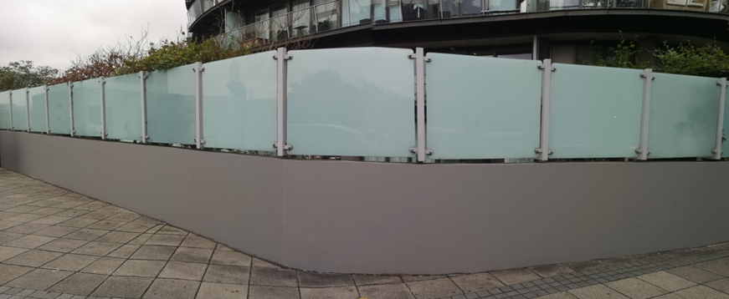
Wall Repairs

Slide 12
Ongoing and Future Works
Working on internal lights throughout the estate
Upgrade of Pond lighting
Installing PIR sensors.
Sanding and painting of planters and benches
Uplifting of external signages

Slide 13
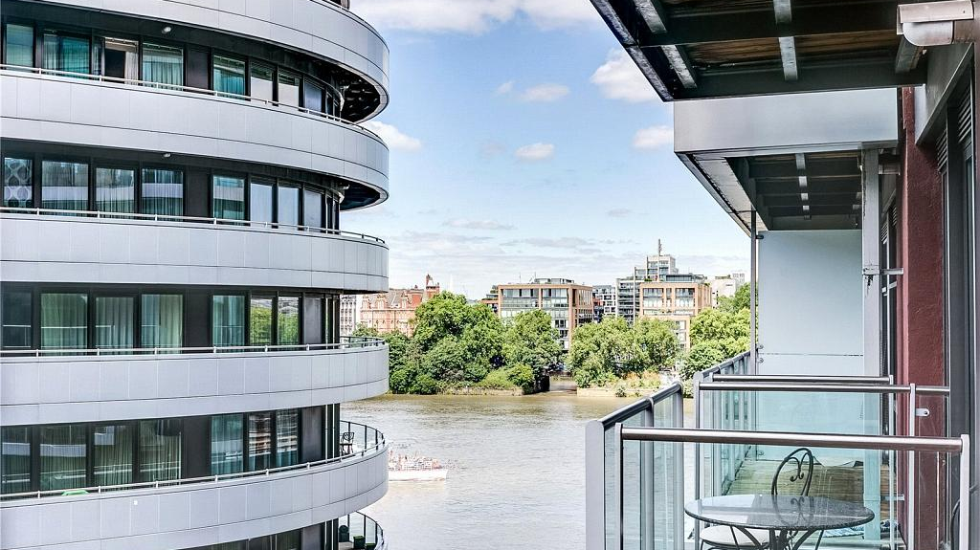
CAPITAL EXPENDITURE WORKS
Upgrade Intercom system
Automated Barrier Sopwith way
Refurbishment of Ponds
Upgrade communal entrances
Re point Piazza stone work
Lift upgrades
CCTV upgrade
Door entry System upgrade
Bollards outside Garton Jones

Slide 14
Meeting Q&A
Q: Intercom System Timing/Repairs and Upgrades
A: New maintenance company appointed, currently working through the estate recommissioning the system. Completion within 1 month. New touch free exit buttons being installed on all gates
Q: Do all blocks contribute to the ponds
A: Yes all block do, it comes out of the estate funds
Q: Piazza lift/Warwick and Oswald update.
A: Piazza lift repair 06/01/2022. Warwick lift 17/01/2022. Oswald Lift 12/01/2022
Q: Why does it take so long to get lifts up and running.
A: lifts being 20 years old, so spares are not readily available, We will be proceeding with internal lift upgrades which would entail a tender to which we would also utilize spares around the rest of the estate so down time would be minimal, Tender would be open to all manufactures.
Q: Are we doing anything to the poor state of the bin areas:
A: Yes, we will be repairing/Replacing doors with plates to prevent further damage in the future, repainting of bin rooms will also be scheduled
Q: Fountains
A: We have appointed a new maintenance company to manage the fountains, to date we have made some good progress in keeping them functional and we expect to improve on this. Survey has been requested.
Q: When will the cladding come down.
A: I have attached the last update sent out by Berkeley’s

Slide 15
Thank you for your continued support

